Slide 1
CAPE-k Student Workshop Potential Projects
Project Pitches

Slide 2
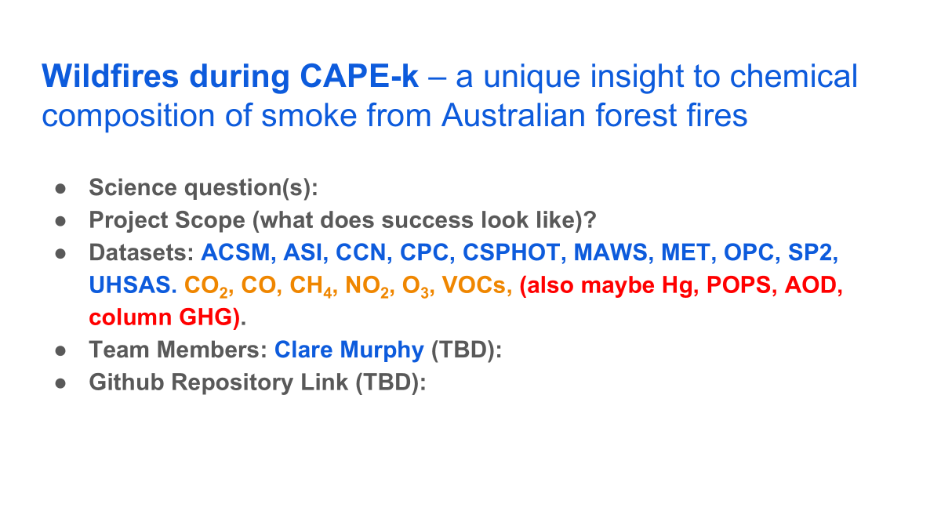

Example: Aerosol influence on snowpack and local hydrologic processes during SAIL
Science question(s):
Where do peak dust and black carbon (BC) events occur?
How do these peaks correlate with changes surface albedo/surface sw radiation?
Observe changes in snowpack surrounding these events
Project Scope (what does success look like)?
Observe BC spikes in data - SP2 (measurement)
Corresponding change in surface albedo/surface sw radiation (wrf simulation)
Snowpack depth/snow water equivalent data (measurement)
WRF simulations of high dust/BC events to observe if changes in snowpack are captured
Datasets: Aerosol concentration, albedo/sw radiation measure, WRF simulations, snowpack depth, HYSPLIT model
Team Members: Yan Xie, Zhenli Lai (Joy), Maiqi Zhang, Jessica Gasparik, Hayden Webb, Ryan Poland, Adrian Cortes
Github Repository Link (TBD):

Slide 3
Aerosol Source Connection to Air Mass History and Hygroscopicity During CAPE-k
•Motivation
•Understand how various aerosol sources impact aerosol-cloud interactions during CAPE-k
•Science question(s):
•How do aerosol size distributions and chemical composition change with air mass source (wind direction)?
•How does aerosol hygroscopicity relate to aerosol size distributions and chemical composition?
•Project Scope (what does success look like)?
•Time series of aerosol size distributions (SMPS, UHSAS, APS)
Andi interested in the APS time series
Kayleigh/Tiantian CCN time series
Sam perhaps predictions of CCN/CN from wind speed data?
Bakhat
•Wind rose plots of total CN and distinct aerosol size ranges (e.g., accumulation mode)
•Time series of CCN/CN
•Wind rose plots of CCN/CN
•Time series and wind rose plots of sulfate, nitrate, ammonium, organic carbon (ACSM), and soot (SP2)
•Datasets: CCN, CPC (two size cuts), SMPS, APS, UHSAS, ACSM, SP2
•Team Members: Andy Ault, Kerri Pratt, Steve Siem, Kayleigh Reilly, Tiantian Zhu, Andi, Bakhat Rawat, Andreas Schmiit, Sam Lee
•GitHub Repository Link (TBD):

Slide 4
Quantifying the seasonal relationship between wind speed and sea spray during baseline conditions
Science question(s): How much does the wind speed contribute to the seasonal variation in sea spray observed at CGO?
Project Scope: Examine the co-variability of wind speed and aerosol concentration across a range of temporal scales. Establish the season cycles in wind speed and heading during baseline conditions. Similarly establish the seasonal cycle in baseline CCN, breaking this down further to focus on sea spray and high wind speed periods.
Datasets: MET, CCN, sulfates, sea spray
Team Members (Steve Siems + TBD):
Github Repository Link (TBD):

Slide 5
Exploring the impacts of aerosols, precipitation and meteorological factors on open and closed MCC clouds
Science question(s):
Do the open and closed MCC clouds have different aerosol (e.g. CCN/CN) characteristics?
Do the open and closed MCC clouds have different precipitation characteristics?
Are there environmental or meteorological factors (e.g. wind, atmospheric stability) modulate the relationships you observe above?
Project Scope (what does success look like)?
Time series of cloud vertical profile.
Time series and bulk statistics of CCN/CN.
Time series and bulk statistics of precipitation rate; precipitation particle size distributions.
Time series of surface meteorology, Skew-T plots and wind rose plots.
A clear and concise summary/presentation of the cloud-aerosol-precipitation-meteorology relationships you observed.
Datasets: Himawari-9 satellite images (https://www.eorc.jaxa.jp/ptree/index.html), cloud radar, CCN/CN, disdrometer, surface meteorology, radiosonde soundings
Team Members: Yi, Nasim, Kyndra, Emily, Britty, Zhaoyang, Jason, Hayley, Abhishek, Carl
Github Repository Link (TBD):

Slide 6
Oxidative capacity during CAPE-k –insights to how cleaning the atmosphere is / gas to aerosol nucleation…
Science question(s):
Project Scope (what does success look like)?
Datasets: AMS, ACSM, MET, AERI, PTRMS, All-sky images, Radiative fluxes. Sulfates, DMS, MSA, O₃, NO₂, CO, HCHO, glyoxyl, halogen radicals, H₂O, photolysis radiation, radon
Baseline sector
Radiation – photolysis rates
Team Members: Robyn S. and Branka M.(TBD): Abitha, Caleb, Alanah, Simon, Siwe
Github Repository Link (TBD):

Slide 7
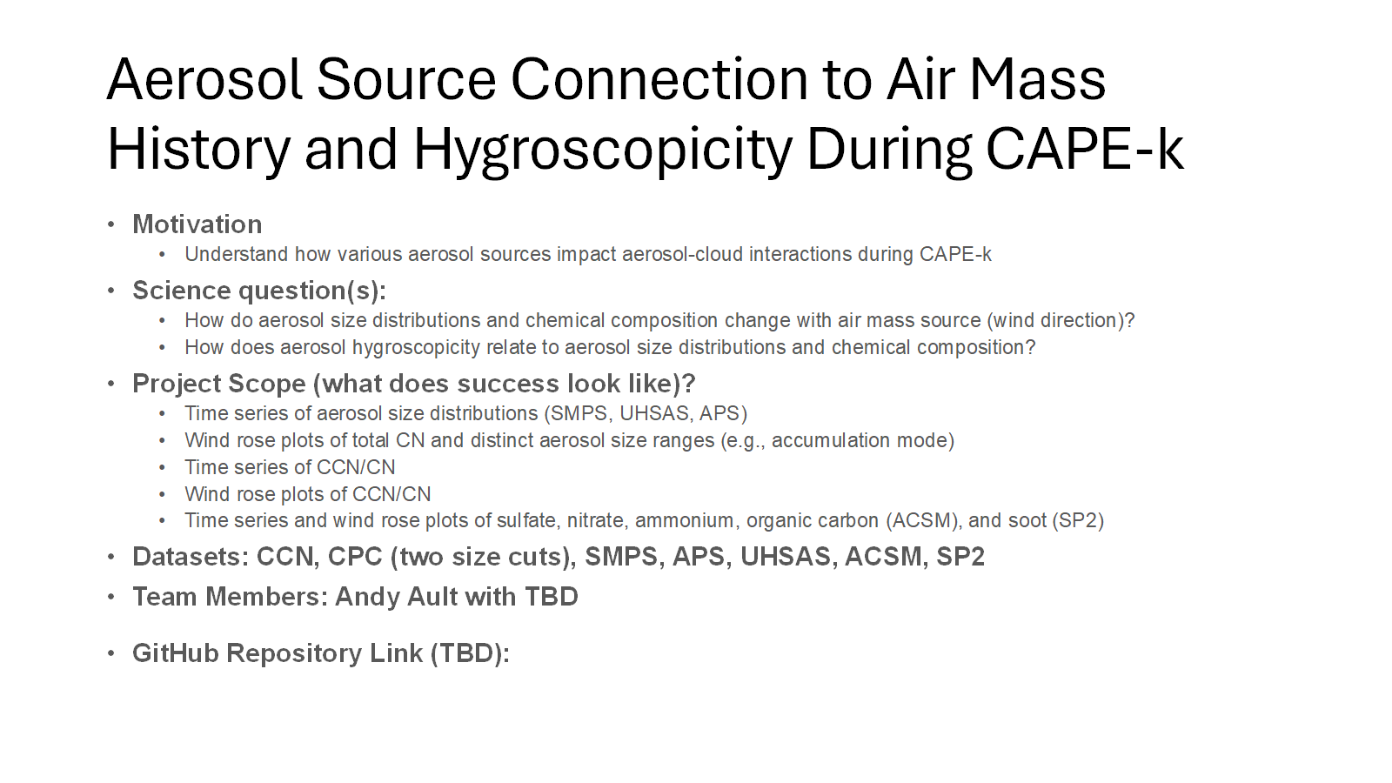
Project Title
Science question(s):
Project Scope (what does success look like)?
Datasets:
Team Members (TBD):
Github Repository Link (TBD):

